Slide 1





Water Energy Synergy
WATER SUPPLY AND ENERGY USAGE IN AFRICAN REGIONS
BENEDICT OUMA
August 29th, 2025
Email Address | Telephone | WhatsApp

Slide 2



INTRODUCTION
Context:
Access to reliable water and energy is a cornerstone of sustainable development. Many African regions face disparities in water availability, energy access, and infrastructure, which affect economic growth, public health, and quality of life. Effective resource planning requires understanding regional needs and potential for renewable energy deployment.
Objective of the Analysis:
Classify regions according to solar energy potential.
Identify areas with critical water and energy shortages.
Provide data-driven recommendations for resource allocation to improve access and sustainability.

Slide 3


PROBLEM STATEMENT
Many regions experience inadequate water supply and energy access, while investments in renewable energy (e.g., solar) are often not optimally targeted. Therefore, the decision-makers need insights to:
Predict solar performance tiers for efficient solar panel deployment.
Identify high-need regions for water and energy interventions.
Allocate resources strategically to maximize impact.
Goal:
Develop a data-driven framework to prioritize regions and guide infrastructure investment decisions based on water, energy, and socio-geospatial indicators.

Slide 4
DATA DESCRIPTION
Feature | Description | Data Type | Feature Type
Rainwater_Harvesting_System | Count of rainwater harvesting systems | Numerical | Original
Tap | Count of public taps available | Numerical | Original
Unimproved | Count of unimproved water sources | Numerical | Original
Unimproved_Large_Diameter_Well | Count of unimproved large diameter wells | Numerical | Original
Unimproved_Rainwater_Harvesting_System | Count of unimproved rainwater harvesting systems | Numerical | Original
Unimproved_Well | Count of unimproved wells | Numerical | Original
Unprotected_Spring | Count of unprotected springs | Numerical | Original
Untreated_Surface_Water | Count of untreated surface water sources | Numerical | Original
Average_Nighttime_mean | Proxy for energy access (average night-time light intensity) | Numerical | Original
AREA | Total area of LGA (e.g., in sq. km) | Numerical | Original
Latitude | Latitude coordinate of LGA centroid | Numerical | Original
Longitude | Longitude coordinate of LGA centroid | Numerical | Original
PERIMETER | Perimeter of the LGA boundary | Numerical | Original
Population | Total population of the LGA | Numerical | Original
Distance_to_Center | Distance from LGA centroid to its state centroid (in degrees) | Numerical | Engineered
pop_density | Population density (Population / AREA) | Numerical | Engineered
safe_water | Count of safe water sources (Borehole, Tap, Overhead_Tank, Rainwater_Harvesting_System) | Numerical | Engineered
unsafe_water | Count of unsafe water sources (Unimproved sources, unprotected spring, untreated surface water) | Numerical | Engineered
safe_ratio | Proportion of population with access to safe water | Numerical | Engineered
unsafe_ratio | Proportion of population relying on unsafe water | Numerical | Engineered
water_diversity | Number of distinct water sources (>0) | Numerical | Engineered
climate_stress | Proxy for climate stress: nighttime light / population density | Numerical | Engineered
accessibility | Proxy for accessibility: distance to center normalized by area | Numerical | Engineered
compactness | Shape compactness metric: (PERIMETER² / AREA) | Numerical | Engineered
Dataset:
Level: Local Government Area (LGA)
Records: 763 LGAs across 37 states
Source: Aggregated water and energy statistics, demographic and geospatial data
Data Characteristics
18 original numerical features
2 original categorical features and 2 empty and unnamed columns
10 engineered features
No null values or duplicates
Key Features
Water Infrastructure: Boreholes, taps, handpumps, rainwater harvesting, unimproved sources
Demographics & Geography: Population, area, perimeter, state, LGA
Energy Proxy: Average nighttime light (for electricity/energy usage)
Spatial: Latitude, longitude, geometry
Feature | Description | Data Type | Feature Type
LGA | Name of the Local Government Area | Categorical | Original
STATE | Name of the state or region | Categorical | Original
Borehole | Count of boreholes available | Numerical | Original
Don't_Know | Count of unknown or unreported water sources | Numerical | Original
Handpump | Count of handpumps present | Numerical | Original
Overhead_Tank | Count of overhead water storage tanks | Numerical | Original

Slide 5

DATA PREPROCESSING
Steps Taken:
Column Cleaning: Dropped irrelevant identifiers and empty columns; standardized column names.
Duplicate Handling: Verified and removed duplicates (none found).
Outlier Treatment: Applied Winsorization (10% lower/upper) on numerical features to cap extreme values while retaining all records.
GeoDataFrame Conversion: Transformed dataset into a GeoDataFrame for spatial analysis and distance-based feature engineering.
Feature Engineering: Created new indicators such as:
Population density (Population / Area)
Safe vs. unsafe water ratios
Water source diversity
Climate stress (Nighttime mean / pop_density)
Accessibility (Distance to state centroid / Area)
Compactness (Perimeter² / Area)
Outcome: Clean, enriched, and spatially-aware dataset ready for exploratory analysis and modeling

Slide 6
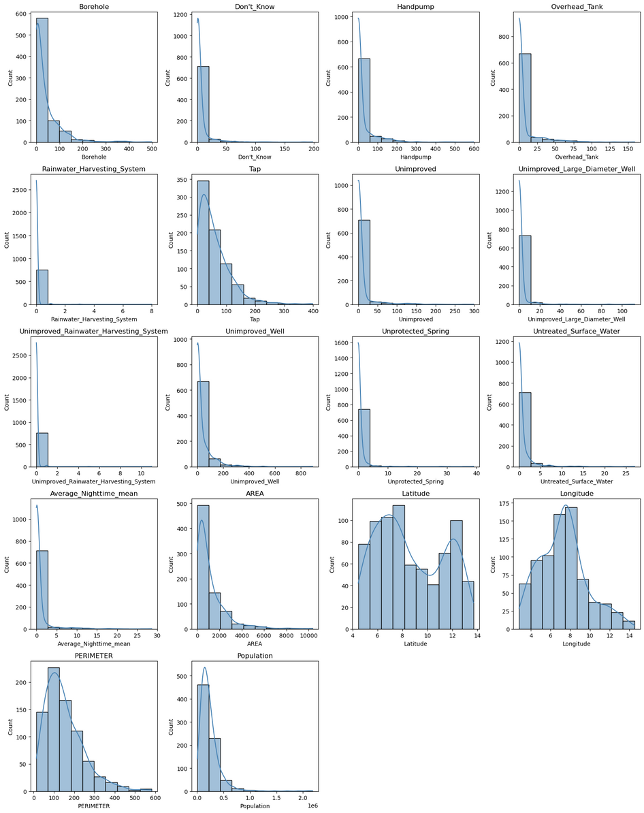
EXPLORATORY DATA ANALYSIS
OUTLIER DETECTION FOR ORIGINAL FEATURES: Histogram Subplots
The histogram subplots of the original numerical features reveal a range of distribution patterns indicative of potential outliers. Many features, such as "Don't Know," "Unimproved," "Unprotected Spring," and "Average_Nighttime_mean," exhibit heavy-tailed distributions, showing extreme values that could disproportionately influence the mean. Several variables exhibit multimodal distributions, indicating the presence of distinct subgroups within the data, while most features display varying degrees of skewness, highlighting asymmetry and potential data imbalance. Additionally, some features, like "Rainwater_Harvesting_System" and "Unimproved_Rainwater_Harvesting_System," have sparse data, which may reflect either low occurrence or collection gaps. Overall, these patterns indicate that a robust outlier handling method is necessary to accurately model the data and account for its complexities.

Slide 7
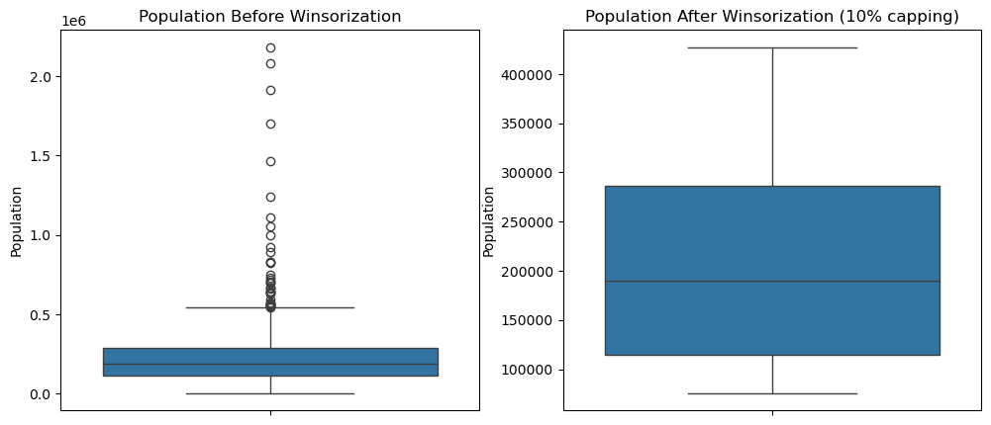
FEATURE COMPARISON (BEFORE AND AFTER OUTLIER HANDLING): Boxplot Subplots
The comparison of population data before and after Winsorization highlights the effectiveness of this technique in mitigating the influence of extreme values. Initially, the distribution was heavily right-skewed, with numerous large outliers pulling the median downward and distorting the overall spread. After applying 10% Winsorization, these extreme values were capped at the 10th and 90th percentiles, substantially reducing visible outliers and producing a more balanced, less skewed distribution. The adjustment also brought the median closer to the box center, reflecting improved symmetry, and lowered the apparent maximum value in line with the capping threshold. Overall, Winsorization transformed the data into a more robust form by limiting the disproportionate impact of extreme values, making it more suitable for statistical analysis and modeling while still preserving the underlying structure of the population distribution.

Slide 8
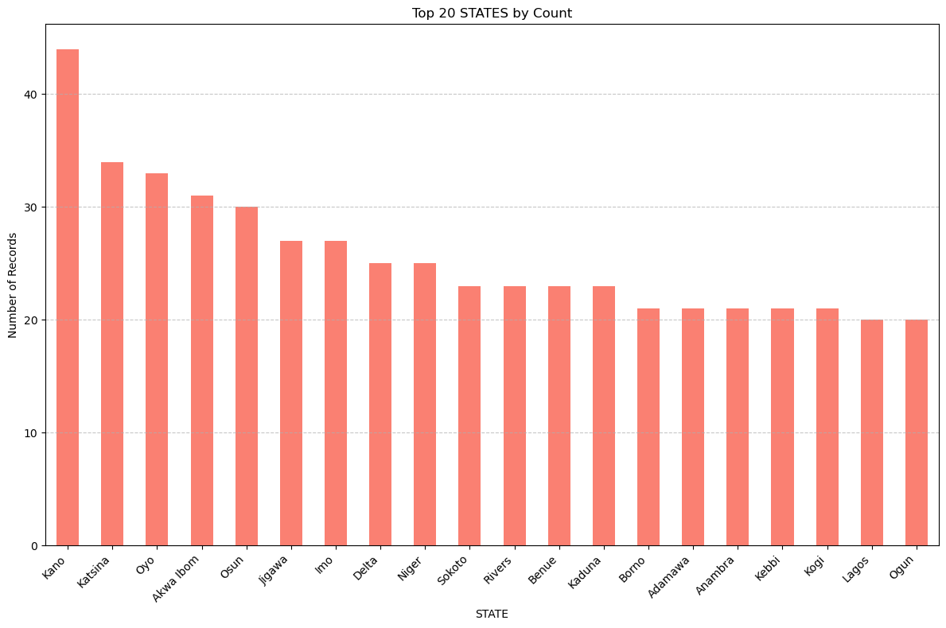
This bar chart presents the top 20 Nigerian states by count, offering a clear view of the states with the highest representation. At this stage, all states are shown in their original form. However, to simplify further analyses, states with fewer than 20 counts were later consolidated into a single category labeled Others, creating a new column called grouped_state while dropping the original state column. This post-visualization adjustment ensures that subsequent analysis and modeling are cleaner, more focused, and less affected by sparsely represented states.
TOP 20 STATES BY COUNT: Bar Chart

Slide 9
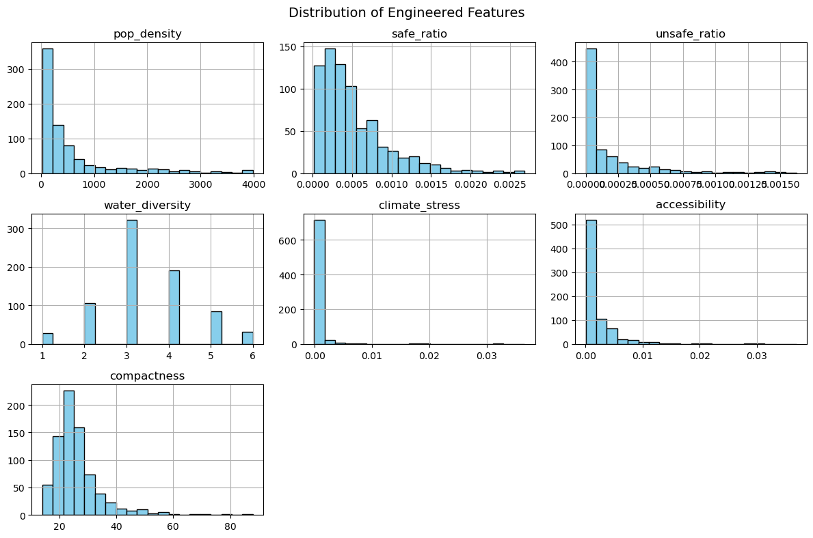
Purpose:
Explore shapes, spread & skewness of features before modeling.
Key Findings:
Water Diversity: Mostly low values (0–2), long right tail → skewed.
Compactness: Multi-modal → suggests distinct groups in data.
Climate Stress: Extremely right-skewed, clustered near 0.
Unsafe Ratio: Like climate stress, heavily skewed near 0.
Accessibility: (Histogram shown; distribution assessed similarly).
Implications for Modeling:
Several features are highly skewed → may need transformations (e.g., log).
Compactness complexity hints at sub-populations.
Real-world features rarely follow normal distributions → preprocessing required.
ENGINEERED FEATURES DISTRIBUTIONS:

Slide 10
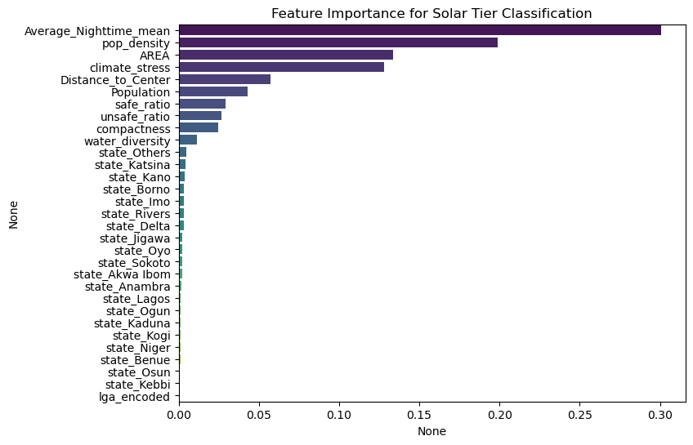
Top Predictors:
Average Nighttime Mean (0.31) - By far the strongest predictor. Satellite nightlight data acts as a proxy for development and electrification, strongly tied to solar tier classification.
Population Density (0.20) - Areas with higher or lower densities influence solar feasibility, demand, and infrastructure planning.
Area (0.13) - Geographic size matters, suggesting land availability impacts solar tiering.
Climate Stress (0.12) - Environmental and climate conditions influence solar adoption potential.
Distance to Center (0.10) - Proximity to urban hubs plays a role in accessibility and infrastructure.
Moderate Contributors:
Population (~0.06) still relevant but less impactful than density.
Safe/Unsafe Ratios & Compactness (~0.02–0.05) contribute small but meaningful signals.
Water Diversity has minimal effect but isn’t negligible.
Least Predictive:
Categorical location variables (state, LGA encodings) contribute almost nothing once richer socio-economic and geographic features are considered.
Key Takeaway:
The model learns primarily from development (nightlights), demographics (density, population), and geography (area, climate, access). Pure administrative boundaries add little predictive power, showing that real-world measurable conditions drive solar tier classification, not location labels.
FEATURE IMPORTANCE INSIGHTS

Slide 11
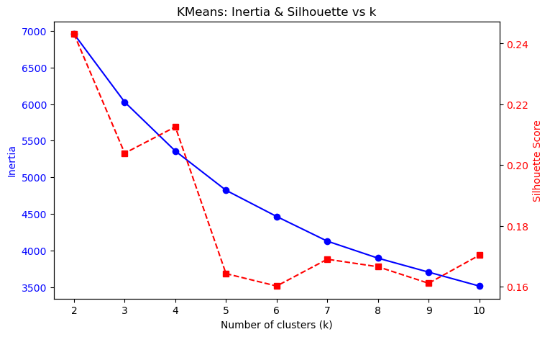
Inertia (compactness):
Sharp drop from k=2 to k=3, smaller improvement up to k=4.
Beyond k=3, gains diminish.
Silhouette Score (separation):
Highest at k=2 and k=3 (\~0.50).
Steep decline beyond k=3 (<0.20).
Interpretation:
k=2: Strong separation, but grouping is less detailed.
k=3: Strong separation and good compactness (best trade-off).
k > 3: Weak separation with minimal improvement in compactness.
Best choice: k=3 clusters → most balanced between separation and compactness.
CHOOSING OPTIMAL K (CLUSTERS)

Slide 12
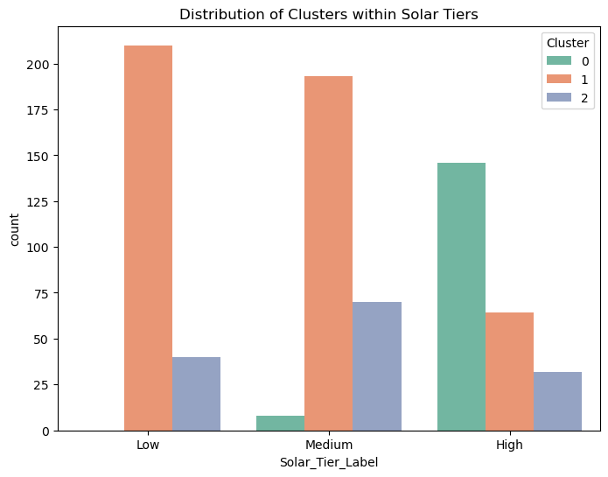
Cluster 0 (Green – High Tier Group)
Contains almost all High Solar Tier data points.
Represents the most advanced/urbanized areas.
Cluster 2 (Blue – Medium Tier Group)
Contains almost all Medium Solar Tier data points.
Reflects moderately developed areas with partial electrification.
Cluster 1 (Red – Low Tier Group)
Contains almost all Low Solar Tier data points.
Represents least electrified or underserved areas.
Interpretation & Insight
There is a very strong alignment between clusters and solar tiers.
The clustering algorithm essentially rediscovered the existing categories, showing that solar tiers are distinct and well-defined.
This validates both the clustering method and the meaningful separation of solar tiers in the dataset.
CLUSTER–TIER RELATIONSHIP OBSERVATIONS

Slide 13
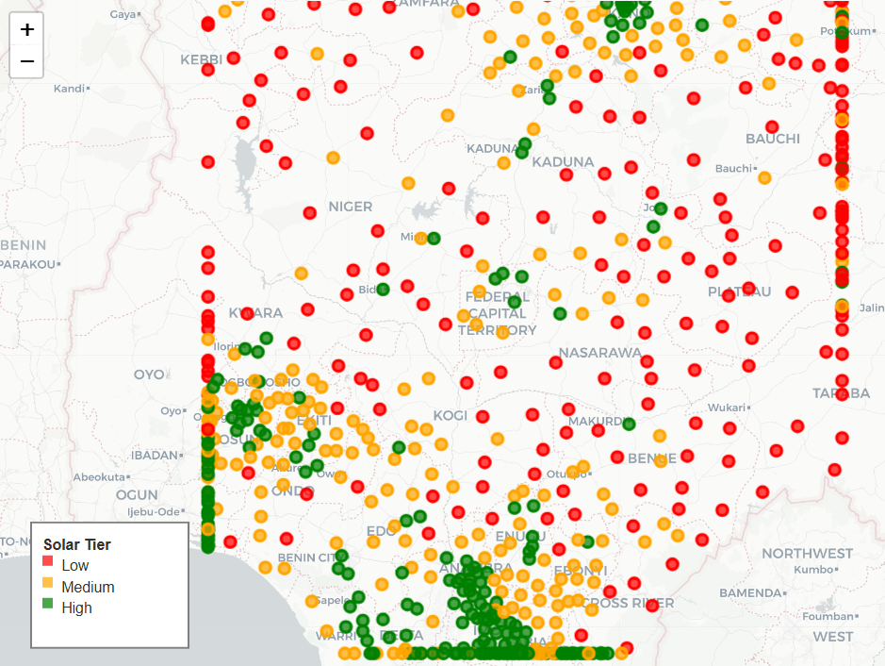
REGIONAL SOLAR PERFORMANCE CLASSIFICATION
This map illustrates the geographic distribution of solar potential across Nigeria, categorized into three tiers: Low (red), Medium (orange), and High (green). The northern region (e.g., Kano, Kaduna, Maiduguri) shows a concentration of High-tier areas, reflecting stronger solar irradiance. Medium-tier zones appear mainly in the central belt (e.g., Nasarawa, Benue, FCT), acting as transitional regions. Low-tier regions are concentrated in the south, where cloud cover and climatic conditions reduce solar resource performance.
Overall, the map reveals clear spatial patterns: the north holds the greatest solar potential, the central belt has mixed results, and the southern states lag. This highlights the importance of strategic investment and solar infrastructure deployment in regions with high potential, while simultaneously improving access and efficiency in areas with lower tiers.

Slide 14



METHODOLOGY
Overview
Approach: Supervised classification of Solar_Tier_Label (Low / Medium / High) + unsupervised clustering for regional segmentation.
Pipeline: Data cleaning → Winsorization (10% cap) → GeoFeature engineering → Encoding/Scaling → Train/validate models → Mapping & interpretation.
Targets & Tasks:
Classification: Predict Solar_Tier_Label.
Clustering: Group regions with similar water–energy–climate profiles (supporting targeting & program design).
Data
Cleaning
Winsorization
Encoding
& Scaling
GeoFeature
Engineering
Train/Validate
Models
Mapping &
Interpretation

Slide 15
Features & Engineering
Original features (examples): Water-source counts (Borehole, Tap, Handpump, Unimproved variants), Population, AREA, PERIMETER, Latitude/Longitude, Average_Nighttime_mean.
Engineered features:
Distance_to_Center: LGA centroid → grouped-state centroid (access proxy).
pop_density: Population / AREA.
safe_water / unsafe_water and safe_ratio / unsafe_ratio.
water_diversity: # of distinct sources present.
climate_stress: Average_Nighttime_mean / pop_density.
accessibility: Distance_to_Center / AREA.
compactness: PERIMETER² / AREA.
Encoding & scaling:
One-hot for GROUPED_STATE (after grouping states with count < 20 into “Others”).
Frequency-encoding for lga.
StandardScaler for clustering-only numeric inputs.

Slide 16

Modeling Setup
Supervised model:
RandomForestClassifier (n_estimators=200, class_weight="balanced", random_state=42).
Train/validation:
Stratified 80/20 train–test split on Solar_Tier_Label.
Clustering:
KMeans on scaled numeric features; k=3 chosen by inertia “elbow” and peak silhouette (~0.50 at k=2–3).
Model selection rationale:
RF handles nonlinearity, mixed scales, and feature interactions; robust to outliers (further mitigated by Winsorization).
KMeans provides complementary unsupervised segmentation to guide program design beyond the label.

Slide 17
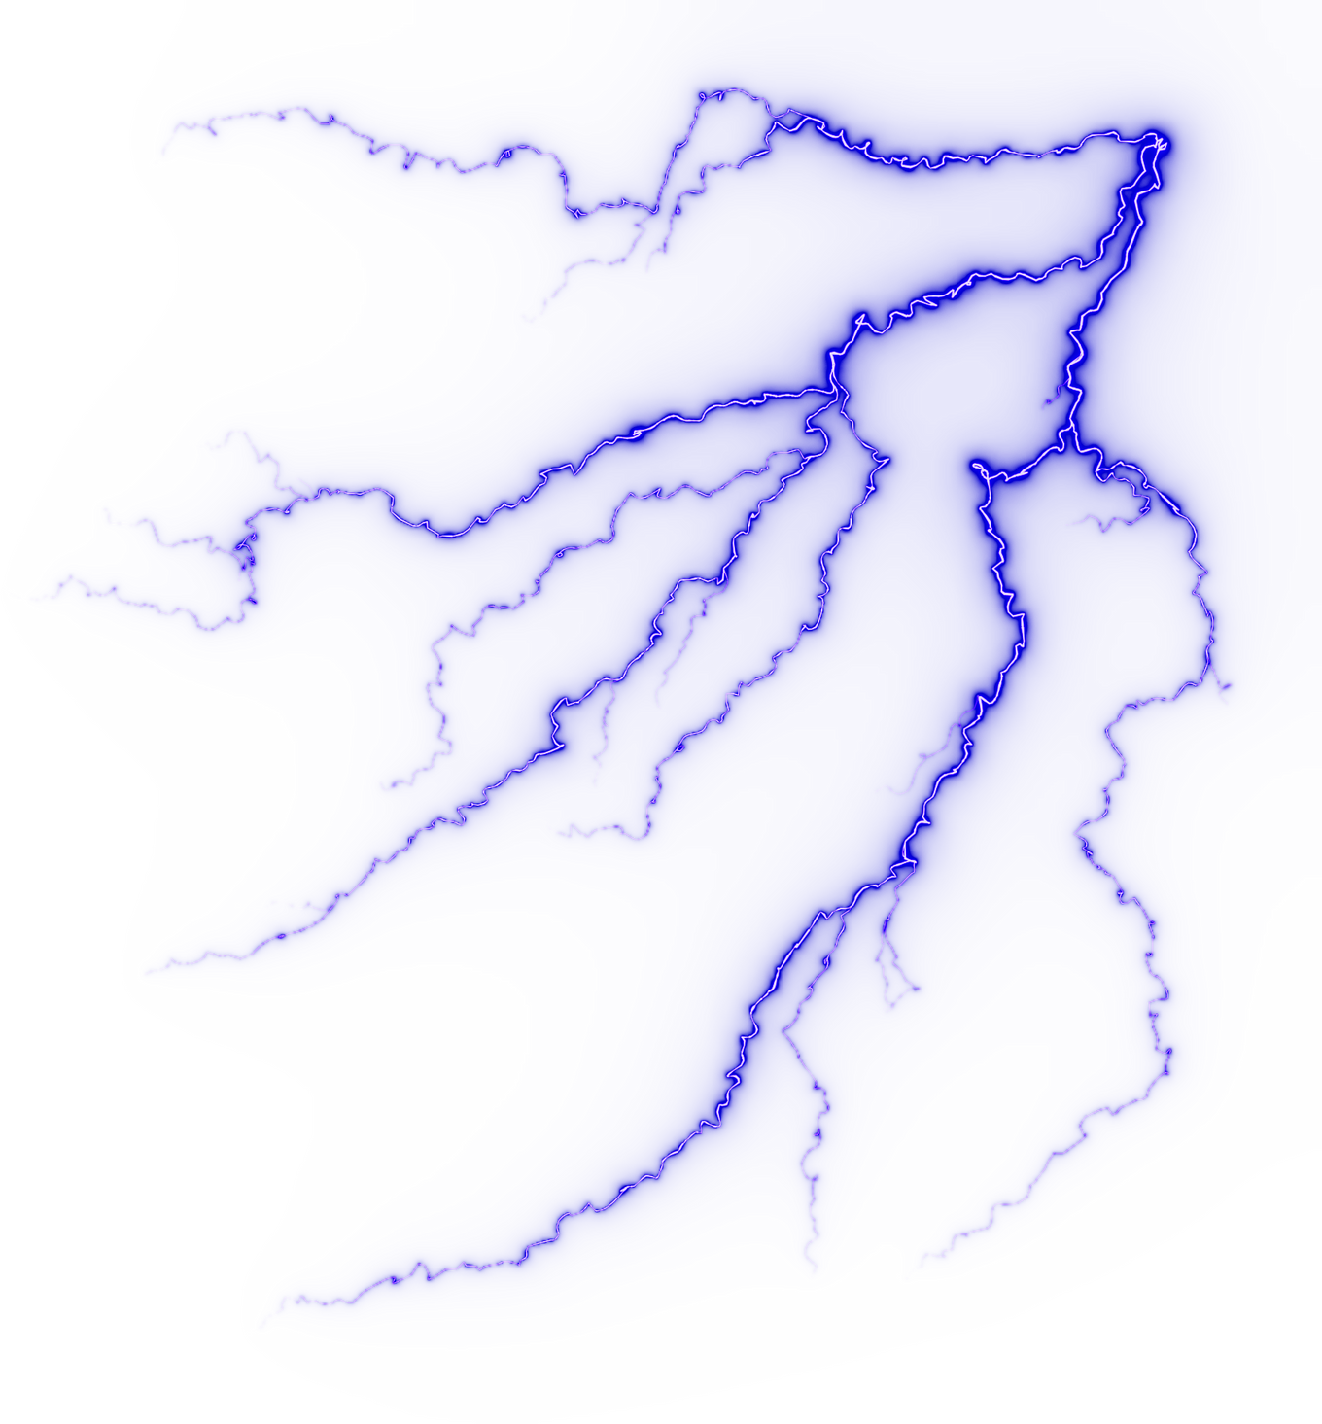
MODELING & EVALUATION
Classification
Test performance (RF, 20% holdout):
Accuracy: 0.95
Per class:
High: Precision of1.00, Recall of 0.90, and F1 score of 0.95 (support 49)
Low: Precision of 0.96, Recall of 0.98, and F1 score of 0.97 (support 50)
Medium: Precision of 0.90, Recall of 0.96**, F1 score of 0.93 (support 54)
Baseline context:
Majority-class accuracy ≈ 35% (predicting “Medium” only) – RF improves accuracy by +60 pts.
Error profile:
Most residual confusions occur between Medium and High, suggesting overlapping feature boundaries in mid-to-high tiers.

Slide 18

FEATURE IMPORTANCE
Clustering
Feature importance (RF):
Most influential: Average_Nighttime_mean (0.31), pop_density (0.20), AREA (0.13), climate_stress (0.12), Distance_to_Center (0.10).
Moderate: Population, safe/unsafe ratios, compactness, water_diversity.
Minimal: Pure location encodings (state dummies, lga_encoded).
Implication: Quantitative development & geospatial factors drive tiers more than admin labels.
Clustering (KMeans, k=3):
Cluster 0 (majority): Spans Low-High, concentrated in Low/Medium.
Cluster 2 (selective): Skews toward High tier (advanced/electrified profile).
Cluster 1 (tiny): Rare/noisy segment.

Slide 19
RESULTS & INSIGHTS
Determinants of Solar Performance: Brightness at night (proxy for development), population density, area/shape, and climate-access factors are the strongest drivers of solar tier classification, while administrative boundaries add little explanatory power.
Spatial Patterns: High-tier regions appear in concentrated pockets (notably in the north and some central states), while Low-tier regions dominate broadly across the country, highlighting pronounced geographic inequality in solar potential.
Segmentation Signal: Cluster 2 corresponds closely to High-tier regions (advanced/electrified profiles), Cluster 0 captures the bulk of Low-Medium regions (general population), and Cluster 1 is a negligible, noisy minority.
Water-Energy Link: Areas with unsafe water burdens and higher climate stress are more likely to fall into lower tiers, often in low-density or peripheral geographies, underscoring the need for integrated water-energy-climate intervention

Slide 20

RECOMMENDATIONS
Prioritize Low-tier, high-need regions:
Water: Boreholes/taps, treatment, and network reliability upgrades where unsafe_ratio is high.
Energy: Decentralized solar mini-grids + storage; target areas with high climate_stress and low accessibility.
Scale differentiated strategies by segment:
Cluster 2 (advanced): Grid-tied/behind-the-meter solar, smart inverters, demand response; accelerate rooftop + C&I.
Cluster 0 (general): Modular mini-grids, PAYGo SHS, phased capacity additions; bundle with water pumping/treatment.
Resource allocation: Use Priority_Index & combined_need_index to apportion budgets proportionally (you computed state-level allocations already).
Program design:
Co-target water + energy (solar pumping + purification).
Focus on peri-urban/rural nodes with long Distance_to_Center and low pop_density.
Leverage geospatial screening (nighttime lights + density) to pre-rank sites.
M&E & risk: Track tier migration over time; monitor performance in Medium↔High boundary regions; hedge climate risk with storage and efficient end-uses (e.g., solar pumping + chlorination)

Slide 21


CONCLUSION
Recap: Built a geospatial ML pipeline to classify solar tiers, segment regions, and integrate water–energy–climate needs into a prioritization framework.
Key takeaways:
Nighttime lights, density, area, climate stress, and access shape solar performance far more than admin labels.
RF achieves strong accuracy (93%) vs. 36% baseline; clustering reveals an advanced segment aligned with High tiers.
Most regions are Low tier → targeted, integrated water–energy investments are needed.
Next steps:
Enrich labels with measured solar yield/uptime; add DNI/GHI, grid proximity, market variables.
Test calibrated probability models, monotonic GBMs, and spatial CV; assess temporal drift.
Operationalize a site-screening tool (dash/map) to route budgets using the Priority/Need indices.

Slide 22
Water Energy Synergy
THANK YOU
Presentation Complete. Click here to access the Streamlit App.

